Slide 1


Lengths in similar shapes
Remember, when a shape is enlarged every length in the shape is multiplied by a given scale factor.
Suppose we enlarge a cube with side length 2 cm by a scale factor of 3:
length ×3
2 cm
6 cm
?
The length is enlarged by a scale factor of 3.
Notes:
Remind pupils that when one object is an enlargement of another the two object are mathematically similar.

Slide 2
Areas in similar shapes
Compare the area of one face of the original cube to the area of one face of the enlarged cube:
length ×3
area ×9
2 cm
4 cm²
36 cm²
6 cm
The area is enlarged by a scale factor of 3².
Notes:
Ask pupils to work out the surface area of the small cube (4 × 6 = 24 cm²) and the surface area of the large cube (36 × 6 = 216 cm²). Notice that the scale factor for the surface area is also 9 (or 3²). Stress that any area on the large cube will be 9 times larger than the corresponding area on the small cube.

Slide 3
Volumes in similar shapes
Compare the volume of the original cube and the volume of the enlarged cube:
length ×3
area ×9
2 cm
8 cm³
volume ×27
216 cm³
6 cm
The volume is enlarged by a scale factor of 3³.

Slide 4
Lengths in similar shapes
length = 1
length = k
In general, if an object is enlarged by a scale factor of k:
area = 1
area = k²
its area or surface area is enlarged by a scale factor of k²
volume = 1
volume = k³
and its volume is enlarged by a scale factor of k³.
Notes:
Generalize the result demonstrated on the previous slide.

Slide 5

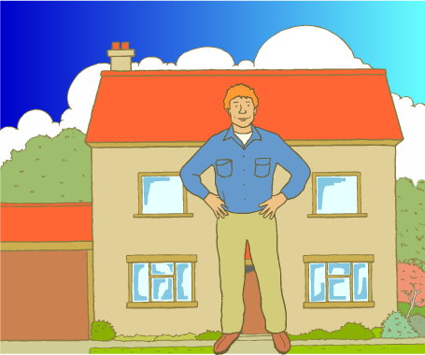
Could a giant survive on earth?
An average man:
A giant man:
Height: 1.7 m
×5
Height: 8.5 m
Surface area: 1.8 m²
×25
Surface area: 45 m²
Volume: 0.07 m³
×125
Volume: 8.75 m³
Could this giant survive on earth?
Notes:
Discuss why, in terms of his surface area and volume, a giant that is five times taller than an average man would not survive on earth. For example, he would have a huge volume compared to his surface area and would overheat.

